Slide 1
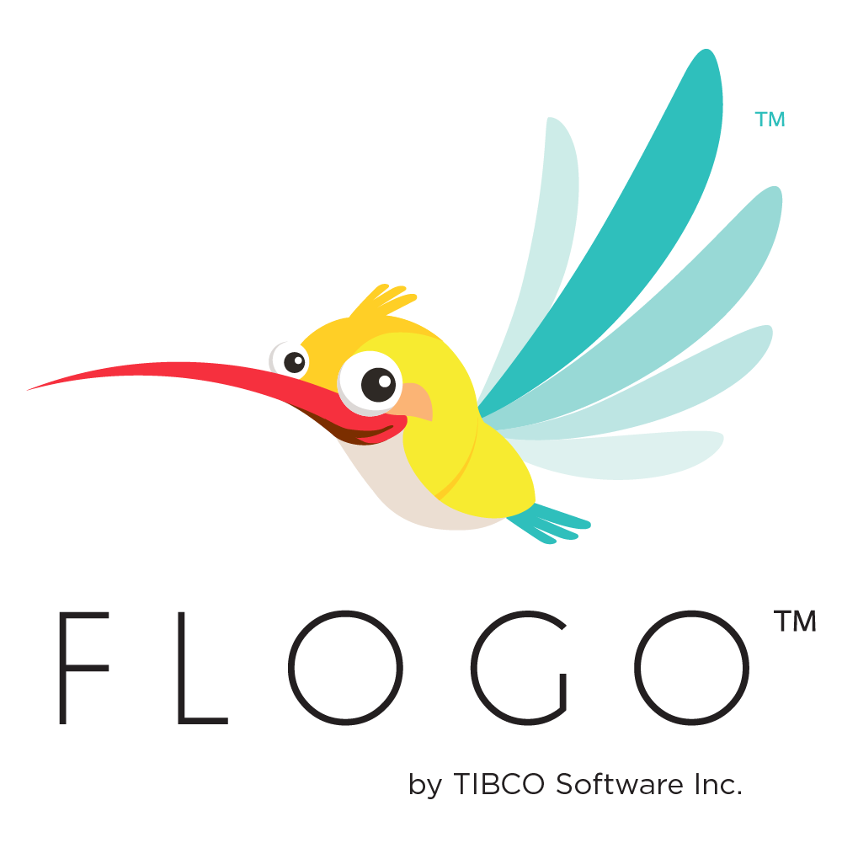
TIBCO FLOGO
Training Day 1
Trainer: Jaydeep
Date: 05/Jul/2023

Slide 2
Agenda
1.Introduce TIBCO Cloud™ Integration
Explain Features
Identify Integration Capabilities
Implement Integration Apps
Explore Monitoring Dashboard
TIBCO Cloud™ Integration - Develop
Benefits
2. Project Flogo®
TIBCO Flogo® Enterprise
Capabilities
Use Cases
Accelerate Development
Deployment Flexibility

Slide 3
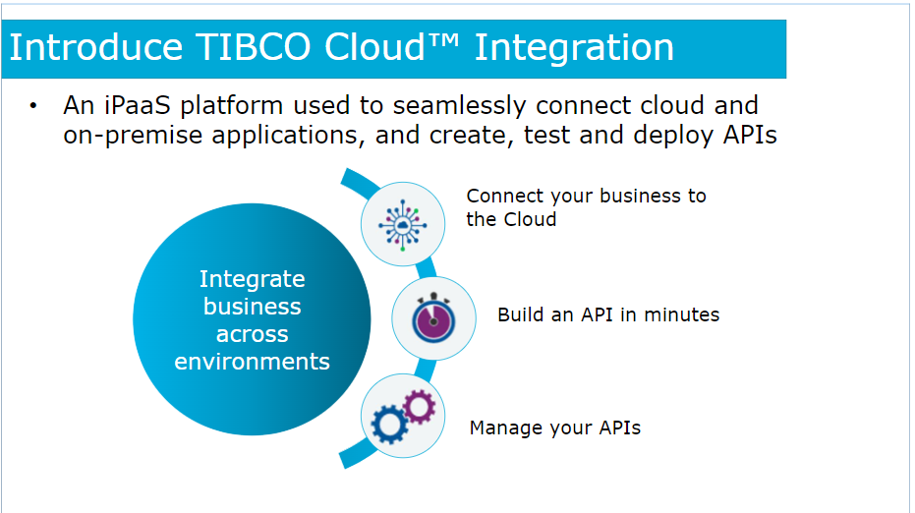
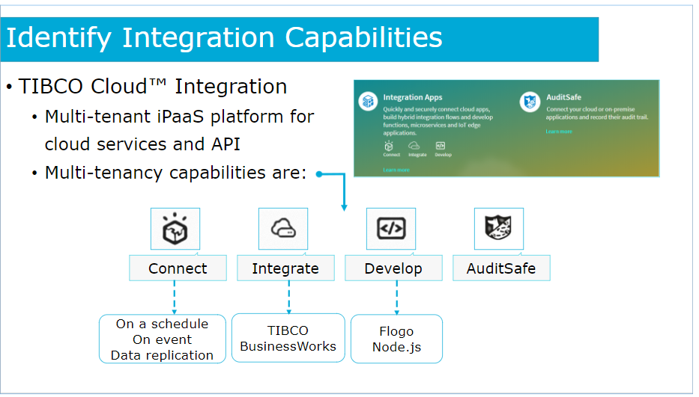
TIBCO Cloud Integration
TIBCO Cloud™ Integration is a cloud-based integration platform that enables organizations to connect various applications, systems, and data sources to facilitate seamless data flow and business process automation. Some key features of TIBCO Cloud™ Integration include:
Connectivity: It provides pre-built connectors and adapters to connect with a wide range of systems and applications, both on-premises and in the cloud.
Data Transformation: TIBCO Cloud™ Integration allows for data transformation and mapping between different formats and protocols, ensuring compatibility and consistency.
Process Orchestration: It enables the design and execution of complex business workflows and process orchestration, automating business processes across systems.
API Management: TIBCO Cloud™ Integration offers API management capabilities to create, publish, and manage APIs, allowing organizations to expose their services securely to external consumers.
Monitoring and Analytics: The platform includes monitoring and analytics features, providing real-time visibility into integrations, tracking performance, and identifying bottlenecks.

Slide 4
Explain Features
TIBCO Cloud™ Integration allows to connect your applications in less time and with limited budgets. The cornerstone of TIBCO Cloud™ Integration is its graphical user interface that allows you to create applications by clicking, not coding.
TIBCO Cloud™ Integration offers connectors for hundreds of applications, databases, protocols, and file formats. Simply enter your credentials, and the connector discovers metadata, including custom objects and fields, and provides operations such as query, lookup, create, update/upsert, and delete.
Extract and migrate your data simply and efficiently. Copy data from an old application to a new one or load production data to a test instance. Use a simple wizard to copy, archive, and analyze your business critical data. Processes are completely automated including scheduling options and auto-detection of changes.
More complex integration flows are handled through rich visual tooling that implements choreography, transformations, and routing options. You have the option to work in a familiar Eclipse-based IDE using an intuitive, full-featured drag-and-drop palette of integration functions.
TIBCO Cloud™ Integration allows you to model your APIs and spin up full fledged mock applications. You can seamlessly start testing even before you implement. You can easily create microservices and have TIBCO Cloud™ Integration manage them for you.
Adopt modern architecture using mircoservices, functions, event-driven processing, using lightweight microgateway, process streaming data from IoT and edge devices, run machine learning models on tiny edge devices, use visual flow editor with smart data mapping, and rely on embedded connectivity. TIBCO Cloud™ Integration offers a wide variety of deployment options: SaaS, embedded within SaaS apps, public and private cloud, native fPaas, native containers (Docker, Cloud Foundry), customer data center, IoT, and edge devices

Slide 5
Identify Integration Capabilities
TIBCO Cloud™ Integration is the iPaaS offering from TIBCO. This multi-tenant platform is meant to run cloud services and APIs. According to Gartner: Integration Platform as a Service (iPaaS) is a suite of cloud services enabling development, execution and governance of integration flows connecting any combination of on premises and cloud-based processes, services, applications and data within individual or across multiple organizations.TIBCO Cloud™ Integration is a multi-tenant platform, i.e. it supports following types of applications (tenants)
Connect applications: This capability allows integrators to build data integrations between any combination of cloud-based and on-premise applications. TIBCO Cloud™ Integration - Connect consists of a core integration engine and an extensible set of Connectors.
BusinessWorks® applications: You can connect other native cloud applications such as Salesforce, Marketo with back end applications such as SAP. Also import any existing BusinessWorks® Enterprise applications.
TIBCO Flogo® Apps: These light weight applications are designed using Web Integrator, which provides a browser based design time UI.
Node JS Apps: You can also bring your own Node JS apps and deploy it to TIBCO Cloud™ Integration.
AuditSafe: Using TIBCO Cloud™ AuditSafe easily add cloud audit trails, secured with blockchain, for any application.
Mock Applications: They are mainly used to test your API specification. These code-less applications allow you to define an API spec and test it in the Cloud.

Slide 6
Implement Integration Apps
The concept of app categories is introduced to delineate which app types best fit your particular use case.
TIBCO Cloud™ Integration - Connect: For business users and business application owners to simplify and accelerate cloud connectivity for data across SaaS and other business applications.
TIBCO Cloud™ Integration - Integrate: For integration specialists to implement mission-critical integration and orchestration services, and deploy anywhere including containers.
TIBCO Cloud™ Integration - Develop: For developers to build event-driven microservices and functions to support API-led application development.

Slide 7
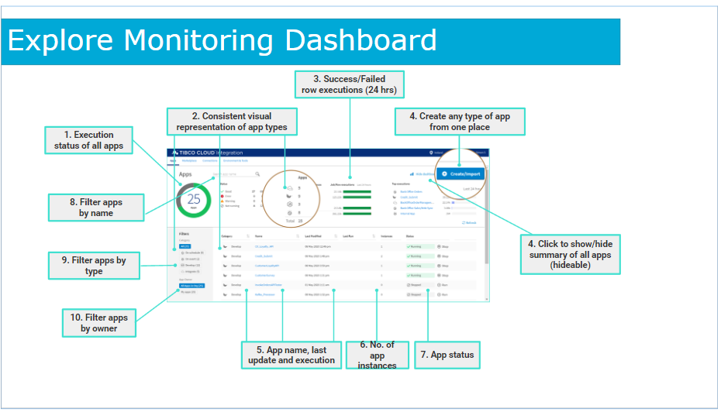
Explore Monitoring Dashboard
Gain complete visibility across all apps in an organization.
App monitoring dashboard for at-a-glance status provides:
Execution status of all apps.
Consistent visual representation of app types.
Success/Failed row executions in 24hrs and list of top running apps in 24hrs.
Create/Import button to create or import any type of app from one place.
Summary view of all apps (hideable).
App-by-app details like app name, last update,
execution status, number of app instances and app status.
Filter the app list by name, type and owner.
Create/Import app option for all app types.
App endpoints available from the apps list.

Slide 8
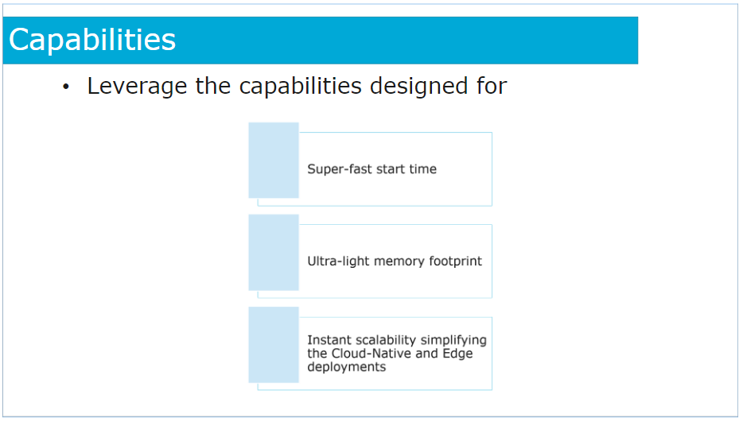
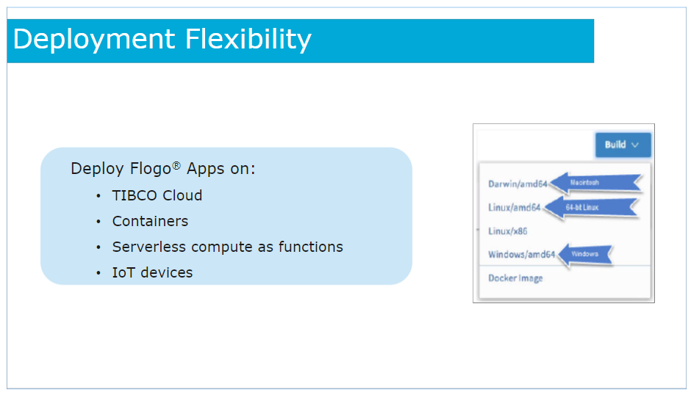
TIBCO Flogo® (TIBCO Cloud™ Integration - Develop)
TIBCO Flogo® (TIBCO Cloud™ Integration - Develop): TIBCO Flogo® is a lightweight, open-source framework for building event-driven applications and microservices. It is part of the TIBCO Cloud™ Integration platform and is specifically designed for developing lightweight and scalable integrations. TIBCO Flogo® offers the following features:
Visual Development: Flogo® provides a web-based visual development environment that allows users to visually design integration flows using a flowchart-like interface.
Event-Driven Architecture: Flogo® focuses on event-driven architecture, enabling developers to build applications that respond to events in real-time.
Low-Code Approach: With its visual development environment and a library of pre-built activities, Flogo® simplifies the development process and allows for rapid prototyping.
Cross-Platform Support: Flogo® supports various deployment options, including cloud, edge, and IoT devices, allowing for flexibility in deployment scenarios.
TIBCO Flogo® Enterprise: TIBCO Flogo® Enterprise extends the capabilities of the open-source framework with additional features and enterprise-grade support, ensuring scalability and reliability for mission-critical applications.

Slide 9
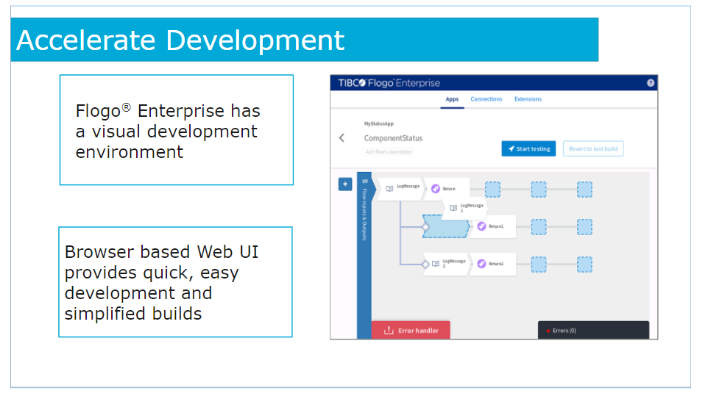
TIBCO Flogo
TIBCO Flogo Enteprise is a modern platform built in Golang
and the core engine of this platform is available as an
Open Source project: Project Flogo.
TIBCO Flogo is designed for the modern integrations:
REST/JSON interfaces
Plugins for modern messaging platforms like Pulsar, Kafka, AWS SQS
AWS technologies: S3, SQS, SNS, DynamoDB, Lambda, Redshift
Azure Data Factory, Service Bus, Storage
Google Cloud Data Store, PubSub, CloudSQL, CloudStorage, Docs, Sheets,
SAP Hana, Redis, MySQL, PostgreSQL, Salesforce, Snowflake, MongoDB,
graphQL,gRPC,Websockets, etc.

Slide 10
TIBCO BusinessWork vs TIBCO Flogo
TIBCO Flogo Enteprise was built from the ground up using Golang, while BWCE is built on Java.
As Golang compiles the code into binaries instead of bytecode that is interpreted by a JVM it is natural that Flogo has better performance than BWCE.

Slide 11
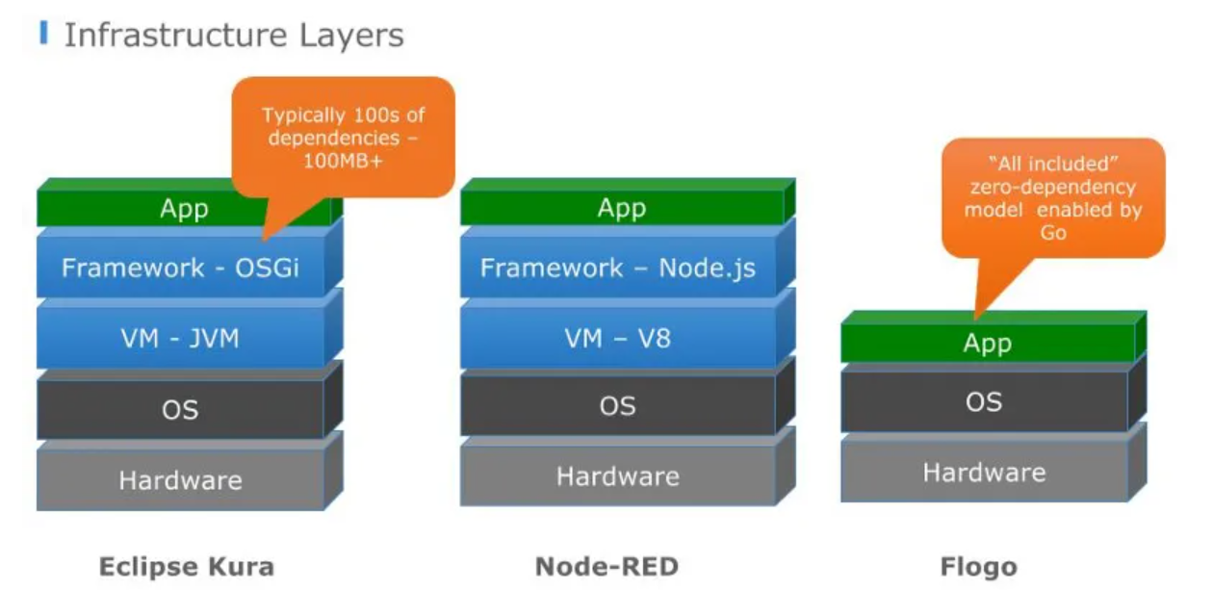
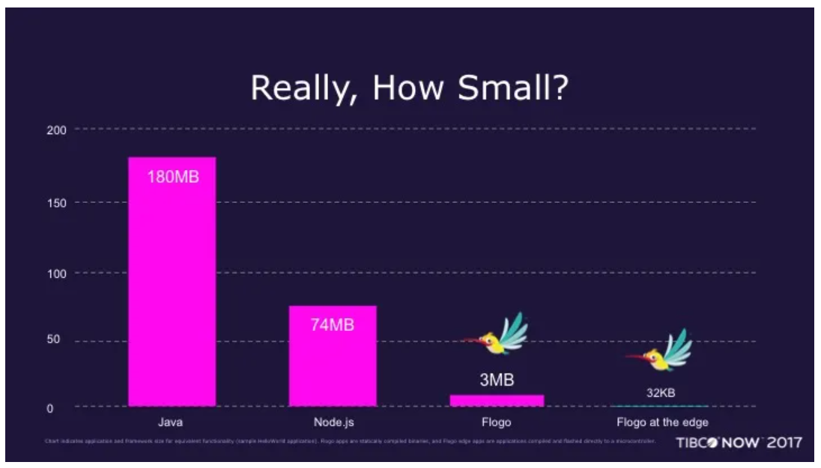
Infrastructure and Memory Utilization
Flogo is based on Go programming language and that makes that the binary executable that it generates only have the exact components you need to run your logic and nothing else.
So, you don’t need an intermediate layer with a virtual machine, like a Javascript V8 engine to run your node application or a JVM to run your Spring Boot services and so on.
No, you only will have in your executable the exact libraries that you need and that makes awesome improvements of the memory footprint that you could have in your flogo developments.

Slide 12
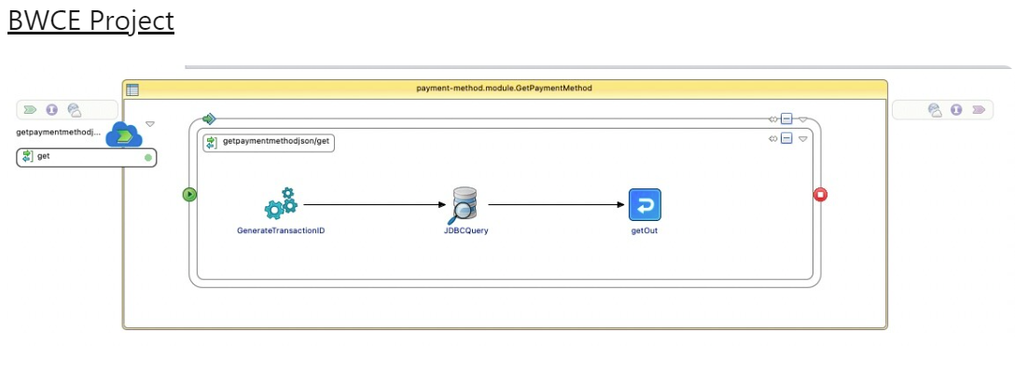
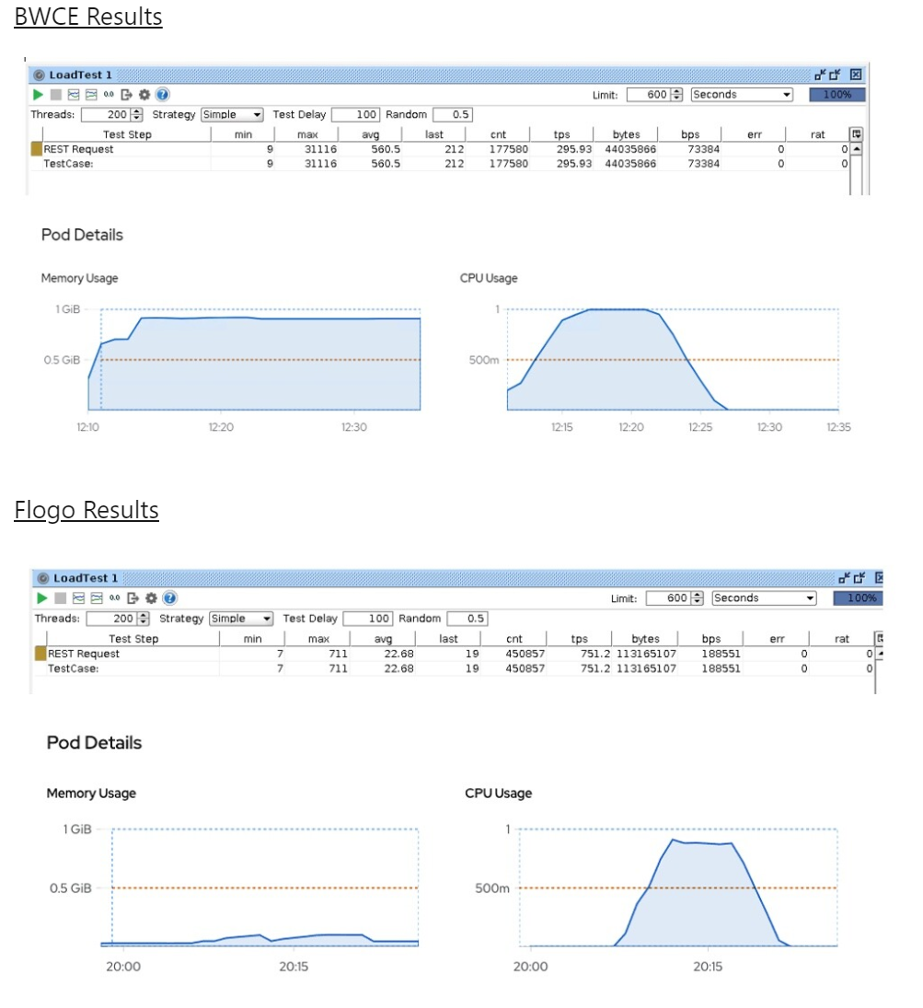
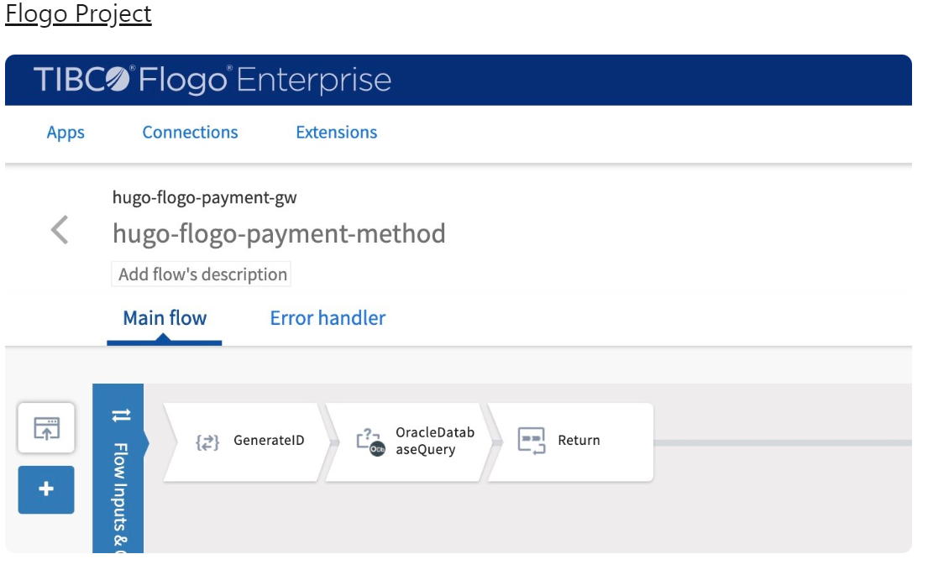
Performance Test Case
The API being exposed is quite simple: GET Method REST/JSON Query data from an Oracle Database
Performance tests were performed in both cases under these conditions in a Kubernetes Cluster: 1 POD 1 GB RAM 1 vCore (1000 mCores) Using BW or Flogo default parameters without optimizations

Slide 13
TIBCO FLOGO Enterprise
You can get docker image of TIBCO FLOGO enterprise from:
https://hub.docker.com/r/flogo/flogo-docker/
Use docker command:
docker pull flogo/flogo-docker
docker run -it -p 3303:3303 flogo/flogo-docker eula-accept
Install Contribution:
github.com/project-flogo/legacybridge/cli

Slide 14
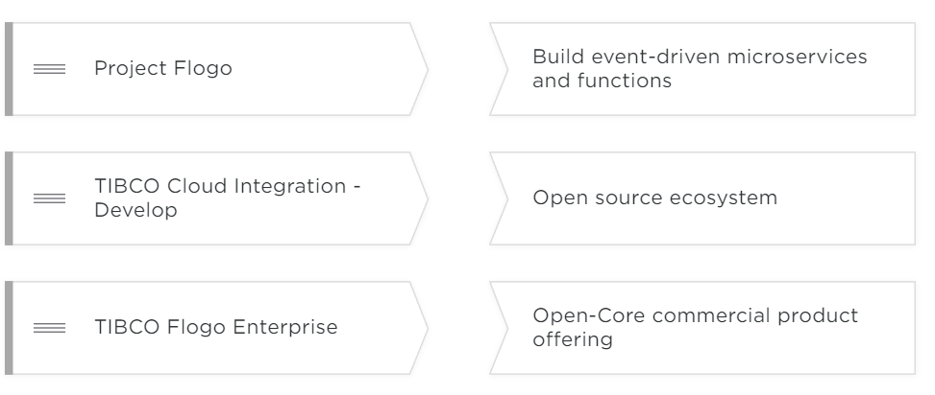
Check Your Knowledge

Slide 15
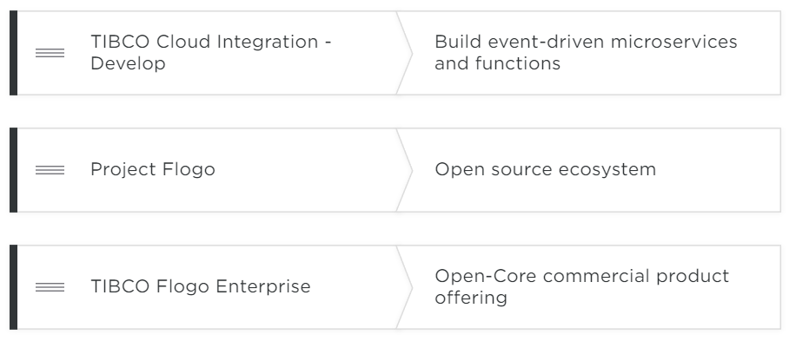
Answer:

Slide 16
Create TCI Account
Register user using email id on https://account.cloud.tibco.com/signup/tci
You will get an activation link to activate account and after that you will need to set up password.
Login:
https://select-region.cloud.tibco.com/?domain=cloud&mode=signin&_ga=2.98518235.514051301.1688492118-847433974.1685516494

Slide 17
Questions?

